Slide 1

OUR PATH TO REVITALIZATION
MONTGOMERY COUNTY CIVIC FEDERATION
NOVEMBER 14, 2022
Notes:
Kerry

Slide 2
Overview
Our Boundaries
Status of the Association in late 2019
Our Plan
Membership Resurgence
Annual Programming
Communications
Notes:
Kerry

Slide 3
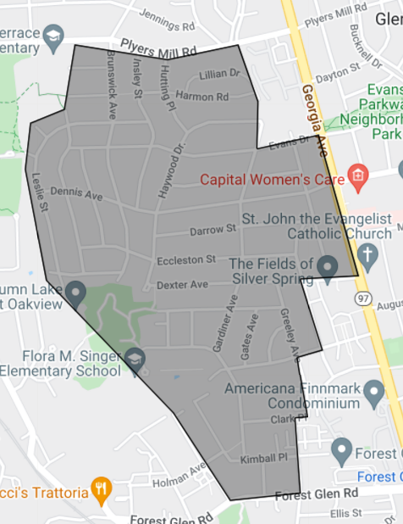
Our Boundaries
Nestled between downtown Silver Spring and Wheaton
  Loosely bounded by Forest Glen to the South, Georgia Ave to the East, Plyers Mill to the North, and Leslie St to the West
Founded in 1992
Approximately 1,100 single family homes.
Notes:
Kerry

Slide 4
Where we were in late 2019
Events with few participants
  Quarterly meetings which barely met quorum
  Long-standing Winter Blues event canceled
  Block Party (our big event!) was sparsely attended
Locked out of the website
Approximately 50 or so paid members
Lots of volunteer effort put into the quarterly printed newsletter with little return on investment
…AND THEN COVID HIT!
Notes:
Kerry

Slide 5




Our plan
EXPAND REACH
INCREASE PAID MEMBERSHIPS
REIMAGINE PROGRAMMING
CREATE NEW SPONSORSHIP PROGRAM
Notes:
Kerry

Slide 6
Expand Reach
Expanded our communications from the quarterly printed newsletter, listserv and website to….
  Facebook Community
  Nextdoor
  Neighborhood Listserv with approx. 600 members.
  E-newsletter
  Used signs and flyers to reach those not online
Notes:
Maggie

Slide 7
Increase Paid Memberships
Began mailings to full footprint
Emphasis of Paypal, recurring membership payments
Yard Signs Encouraging Joining
Recognition of Members in Year-End Newsletter
2021 Membership Total of 240; increased of 400+% over historic levels
2022 Postcard Mailing
Listserv promotion/reminders
Member ‘Get a Member’ campaign.
2022 Membership Total – 246 and counting.
Notes:
Dave

Slide 8
Reimagined Programming
Reorganized Events Committee
Recruited and Engaged Volunteers
Tested New Activities instead of Meetings
Began an Annual Spring Egg Hunt
Expanded the Summer Block Party
Advertised National Night Out
Recreated our Halloween Parade
Launched Membership Survey
Notes:
Kerry

Slide 9
Sponsorship program
Moved from sponsorship of printed newsletter to sponsorship of Association
Sponsorship benefits include:
  Advertisement in our online newsletter twice a year
  Business listing on our website for one year for all members and non-members to view
  Quarterly email to membership highlighting our Association sponsors
Annual Sponsorship Rates:
  $300 for sponsors who live outside our boundaries
  $200 for sponsors who live within our boundaries
Contacted approximately 100 local businesses via email
  Eight sponsors for 2022
Notes:
Maggie

Slide 10
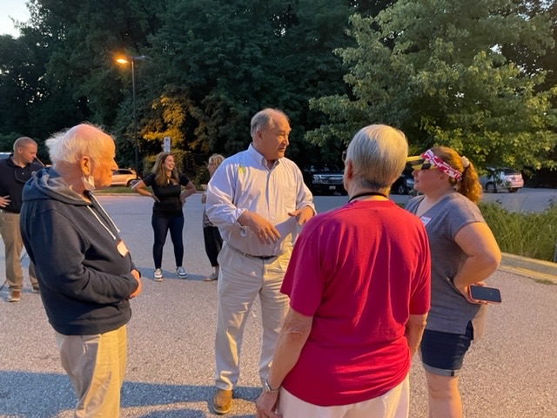
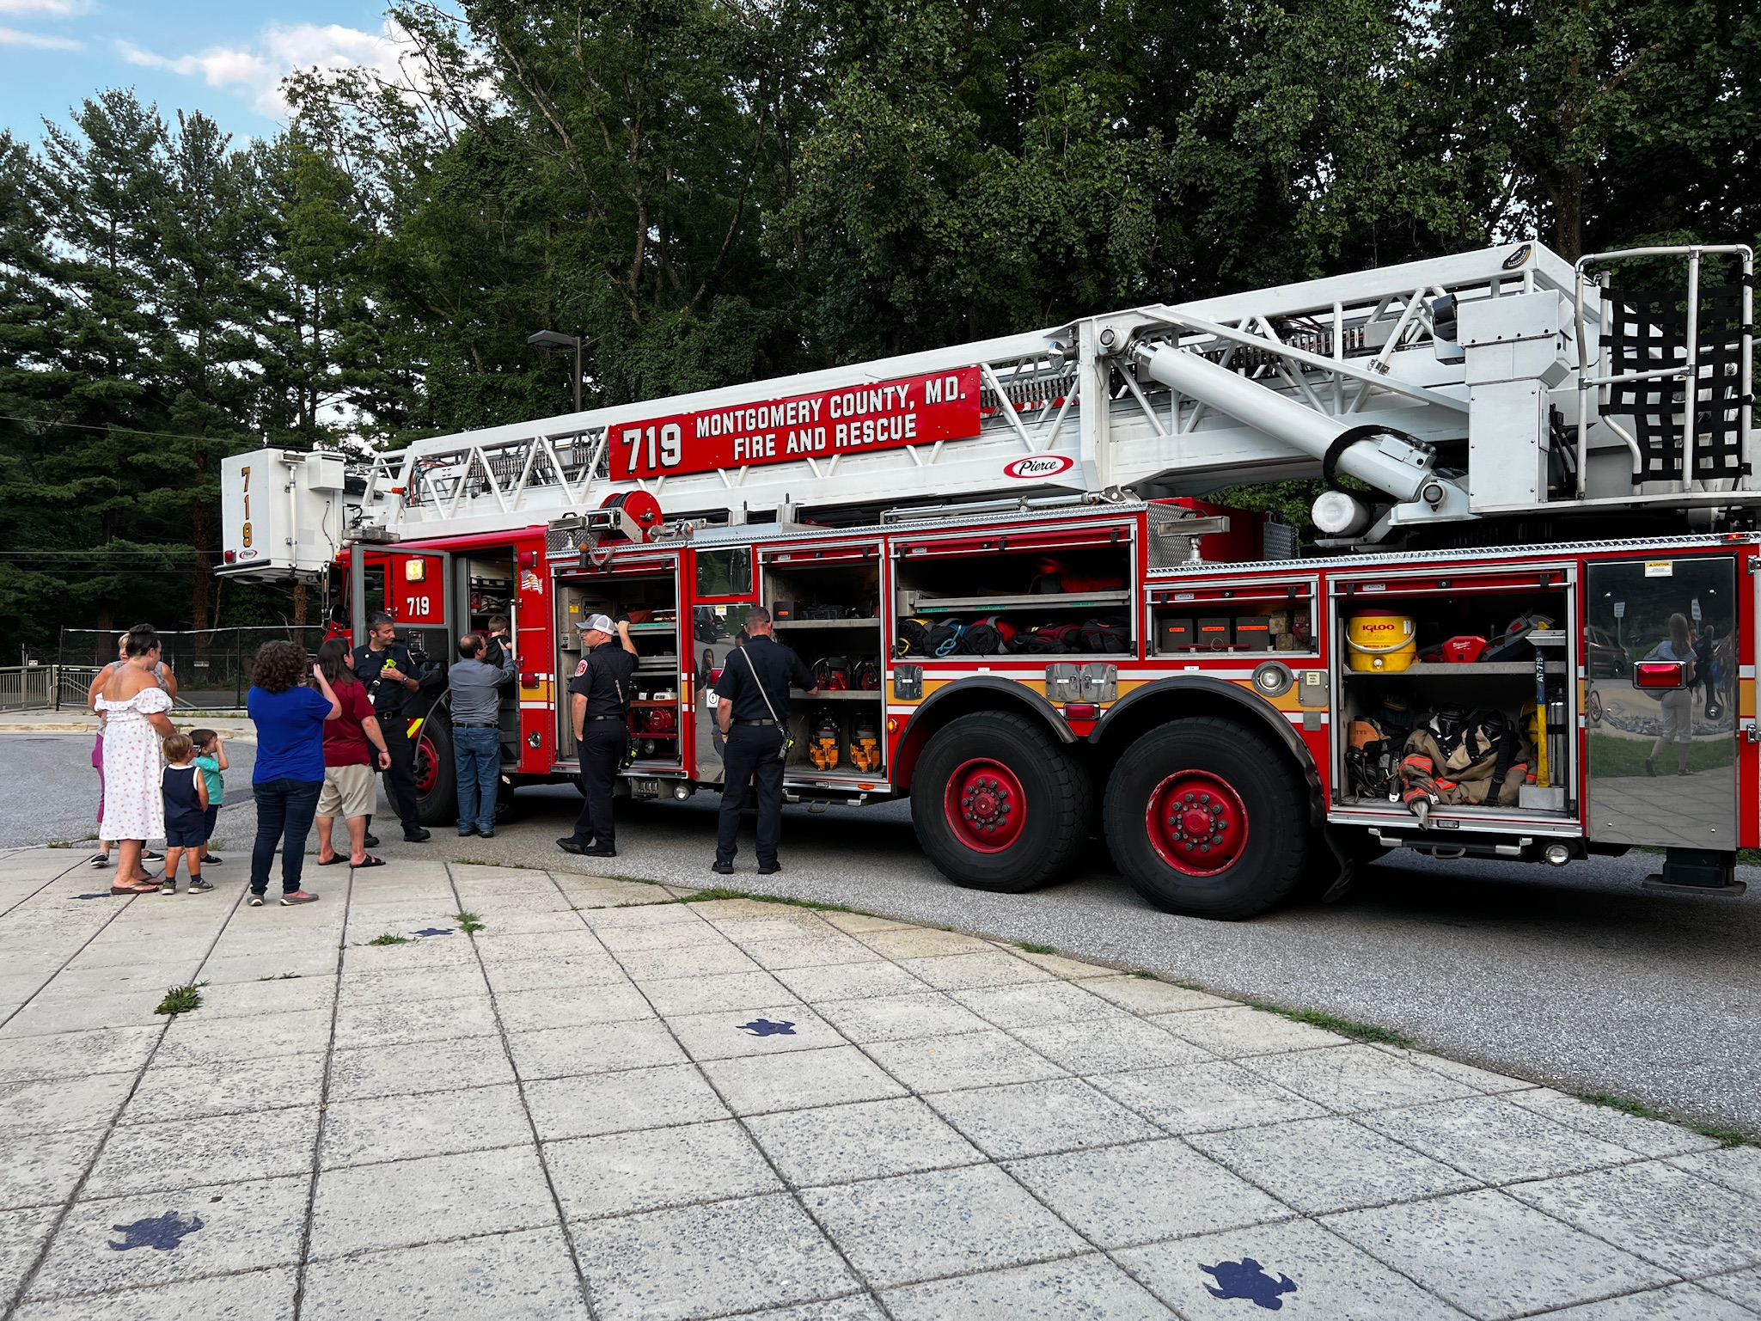
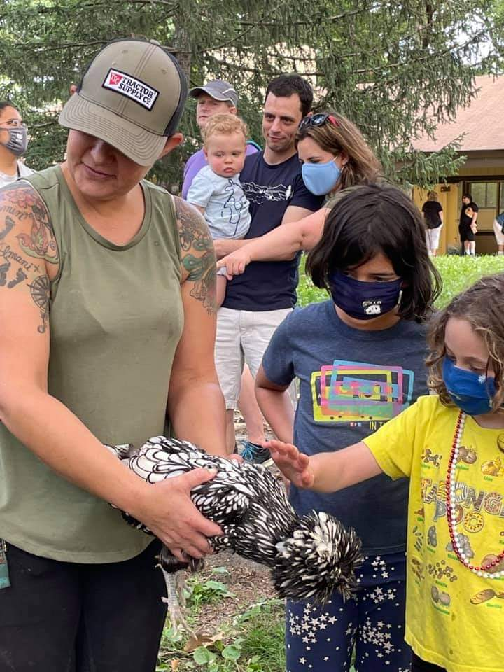
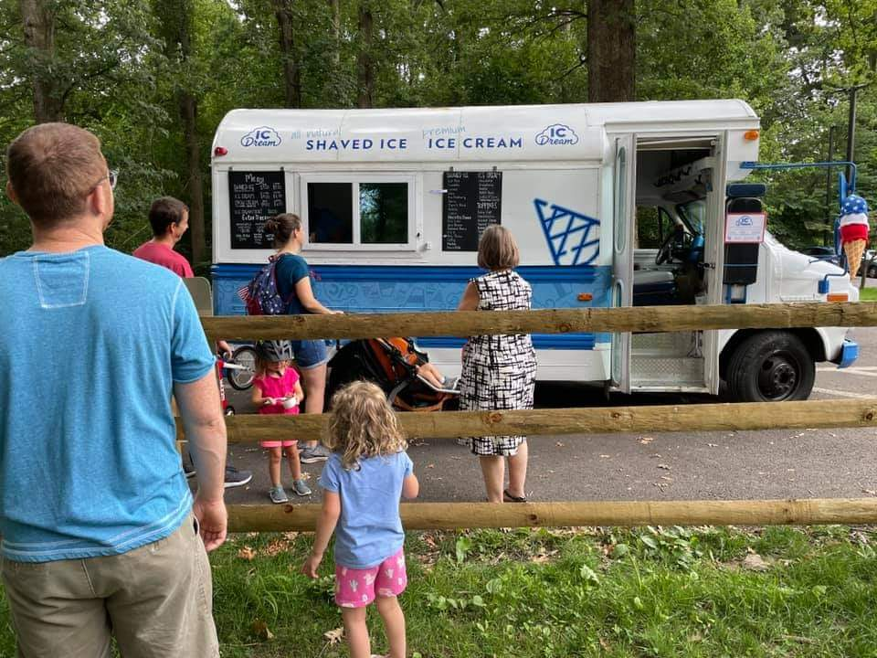
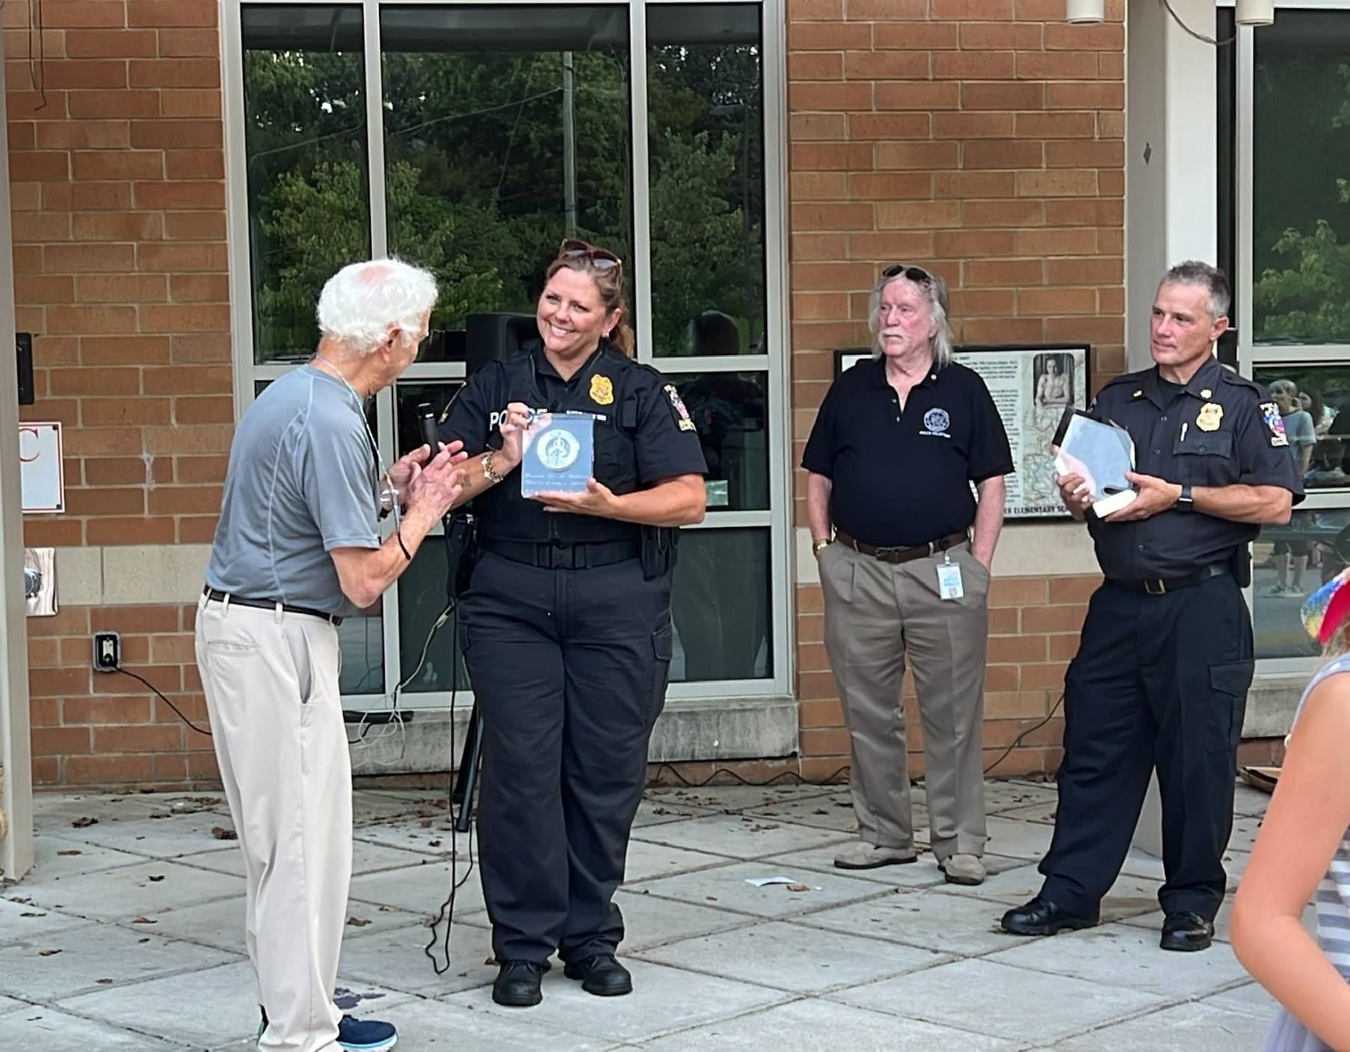
And now….
Notes:
Maggie

Slide 11
Questions / Discussion
officers@mhckcivic.org
events@mhckcivic.org
membership@mhckcivic.org
Notes:
Maggie

